Slide 1



AGE 214: Lecture 10
BJT DC Biasing Techniques & Load Line Analysis
Sokoine University of Agriculture
AGE 214 - Lecture 10

Slide 2



Why do we need Biasing?
Establishing the Q-Point
Transistors need DC voltages to operate in the correct region (Active Region for amplifiers).
•
Biasing is the process of setting the DC operating voltage and current levels.
Q-Point Goal
To keep the transistor in the middle of the active region.
•
The stable point of operation is called the Quiescent Point (Q-Point).
•
Without proper biasing, the signal might be clipped or the transistor might overheat.
Sokoine University of Agriculture
AGE 214 - Lecture 10

Slide 3
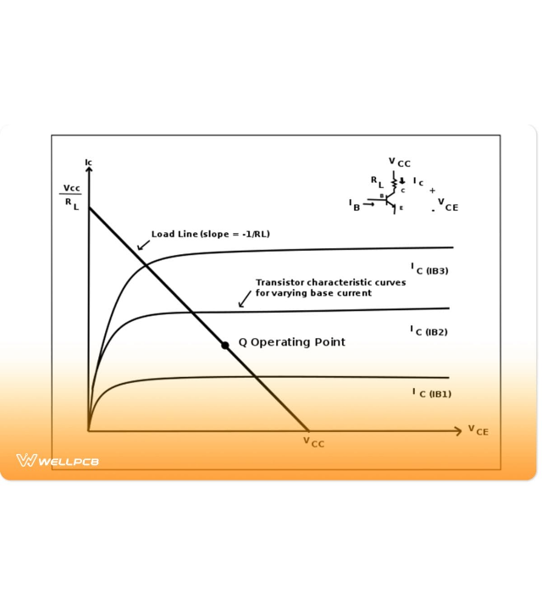
Visualizing the Operating Point
This graph shows the output characteristics (I_{C} vs V_{CE}).
•
Q-Point: The intersection of the Load Line and the transistor curve.
•
Saturation: Maximum current, Switch ON.
•
Cutoff: Zero current, Switch OFF.
•
Active Region: Between the two, ideal for amplification.

Slide 4




DC Load Line Analysis
The Linear Equation
By applying Kirchhoff's Voltage Law (KVL) to the output loop:
Y-Intercept (Saturation)
X-Intercept (Cutoff)
Set $V_{CE} = 0$:
Set $I_C = 0$:
Sokoine University of Agriculture
AGE 214 - Lecture 10

Slide 5

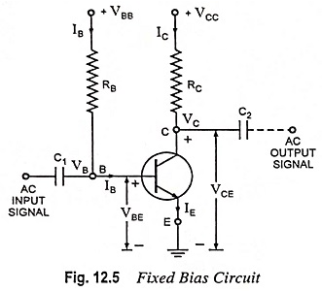


Fixed Bias Configuration
The Simplest Method
Uses a single resistor (R_{B}) to set the Base current.
Drawback: It is thermally unstable. If Temperature rises, β rises, I_{C} rises, shifting the Q-point dangerously.
Sokoine University of Agriculture
AGE 214 - Lecture 10

Slide 6



Emitter-Stabilized Bias
The Modification
Why?
Result
Add a resistor R_{E} at the Emitter terminal.
Negative Feedback! If I_{C} increases due to heat, voltage across R_{E} increases. This reduces V_{BE}, which lowers I_{B} and brings I_{C} back down.
Much better stability than Fixed Bias.
Sokoine University of Agriculture
AGE 214 - Lecture 10

Slide 7
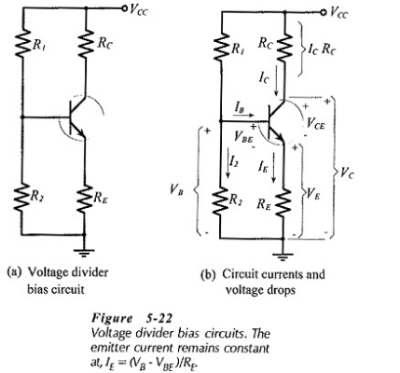
Voltage Divider Bias
The Industry Standard
Uses two resistors R₁ and R₂ to form a voltage divider at the Base.
Beta Independent
The voltage at the base V_{B} is determined by the resistors, not the transistor’s β. This makes it extremely stable against temperature and transistor replacement.
Sokoine University of Agriculture
AGE 214 - Lecture 10

Slide 8






Approximate Analysis
Calculating Q-Point
If $\beta R_E \ge 10 R_2$, we can ignore the base current loading effect.
Step 2: Emitter Voltage
Step 1: Base Voltage
Step 3: Collector Current
Sokoine University of Agriculture
AGE 214 - Lecture 10

Slide 9
Bias Comparison
Configuration | Circuit Complexity | Stability Factor (S) | Beta Independence
Fixed Bias | Simple (1 Resistor) | Poor (High S) | Low (Unstable)
Emitter Bias | Medium (2 Resistors) | Better | Medium
Voltage Divider | High (4 Resistors) | Excellent (Low S) | High (Very Stable)
Sokoine University of Agriculture
AGE 214 - Lecture 10

Slide 10
Questions?
Next Lecture: Field Effect Transistors (JFET)
Dr. Kadeghe Fue
Sokoine University of Agriculture
AGE 214 - Lecture 10

Slide 11




Image Sources
https://upload.wikimedia.org/wikipedia/en/c/c1/SUA.png
Source: wikipedia.org
https://cdn.wellpcb.com/wp-content/uploads/A-Load-Line-Diagram-1200x800.jpg?lossy=1&ssl=1
Source: www.wellpcb.com
https://www.eeeguide.com/wp-content/uploads/2022/11/Fixed-Bias-Circuit-02.jpg
Source: www.eeeguide.com
https://www.eeeguide.com/wp-content/uploads/2019/02/Voltage-Divider-Bias-Circuit.jpg
Source: www.eeeguide.com

